Slide 1
EMAIL SPAM DETECTION USING MACHINE LEARNING
Submitted by : Kartikay Kaushik (RA2211003030241).
Ronak Arora(RA2211003030287).
Mohit Gautam(RA2211003030290).
Submitted To: Mr. Chiranjit Dutta.

Slide 2
ABSTRACT
Project Objective:
Build a machine learning model to detect spam emails accurately.
Data Processing:
Collected a dataset of email messages labeled as spam or non-spam.
Performed text preprocessing and vectorization to convert text into numerical features.
Algorithm Used:
Employed the Multinomial Naive Bayes algorithm for classification.
Selected this algorithm for its effectiveness in handling text-based data.
Model Training and Testing:
Split the data into training and testing sets to validate the model's performance.
Trained the model using labeled data to improve its prediction accuracy.

Slide 3
INTRODUCTION
Email spam detection is a critical challenge that requires advanced techniques to identify and filter out unwanted messages. Big tech companies are always working on making sure they catch all those annoying spam emails and messages before they reach you. It’s a top priority for them to keep their customers happy and spam-free. Machine learning models can be trained on large datasets to detect patterns and characteristics of spam emails, enabling efficient and scalable solutions. Spam emails are unsolicited, mass-distributed messages that often contain advertisements, scams, or malicious content. Spam emails are unsolicited, mass-distributed messages that often contain advertisements, scams, or malicious content. The volume of spam emails has increased dramatically in recent years, necessitating robust detection and filtering solutions. In today's digital age, the challenge of combating spam emails is more pressing than ever. Spam emails, or junk mail, inundate our inboxes with unsolicited and often malicious content, ranging from cryptic messages to scams and phishing attempts.

Slide 4
OBJECTIVE
Our project begins with the preprocessing of a substantial email dataset, encompassing tasks such as data cleaning, handling missing values, and converting text data into a format suitable for machine learning. Email data presents unique characteristics.
We focus on engineering specific email features, such as the sender's address, recipient list, subject line, and email body, to create meaningful inputs for our spam detection model.
We aim to design and evaluate a robust spam detection model. Our choice of machine learning algorithms, including decision trees, support vector machines, and neural networks, seeks to maximize the model's effectiveness.
Identifying potential challenges in email spam detection, including evasive techniques used by spammers, and proposing avenues for future work and research in this domain.

Slide 5
PROBLEM
Identifying Spam Characteristics: Spam emails can have varying content, subject lines, and sender information, making it challenging to develop rules-based detection methods.
Evolving Spam Tactics: Spammers continually adapt their tactics to evade detection, requiring flexible and adaptive detection models.
Balancing Accuracy and Performance: Effective spam detection must achieve high accuracy while maintaining low latency and computational resource requirements.

Slide 6
SOLUTIONS
Data Collection: Gather a large, diverse dataset of both spam and legitimate emails to train the machine learning model.
Feature Engineering: Identify and extract relevant features from the email content, sender information, and metadata to enable effective classification.
Machine Learning Models: We employed a range of machine learning algorithms to train and evaluate the email spam detection model . This model includes decision trees , svms and more

Slide 7
TECHNOLOGIES USED
Python: The primary programming language for data preprocessing, model development, and deployment.
Algorithms: Our choice of machine learning algorithms, including decision trees, support vector machines, and neural networks, seeks to maximize the model's effectiveness.
NLP Techniques: Natural language processing methods for extracting features and understanding email content.

Slide 8
Distribution of Spam VS Ham
# Chart - 1 Pie Chart Visualization Code For Distribution of Spam vs Ham Messages
spread = df['Category'].value_counts()
plt.rcParams['figure.figsize'] = (5,5)
# Set Labels
spread.plot(kind = 'pie', autopct='%1.2f%%', cmap='Set1')
plt.title(f'Distribution of Spam vs Ham')
# Display the Chart
plt.show()

Slide 9
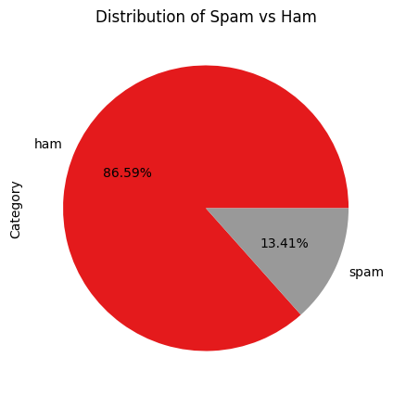
Distribution of Spam VS Ham
OUTPUT:

Slide 10
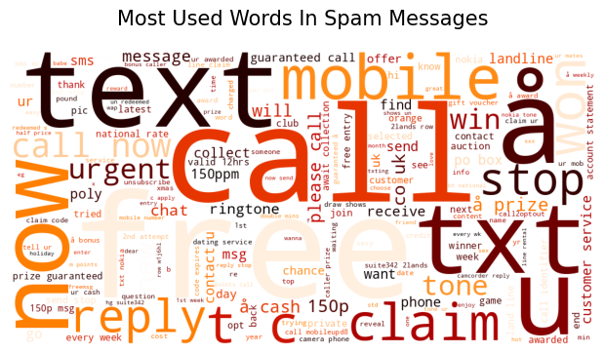
Most Used Words in Spam Emails

Slide 11
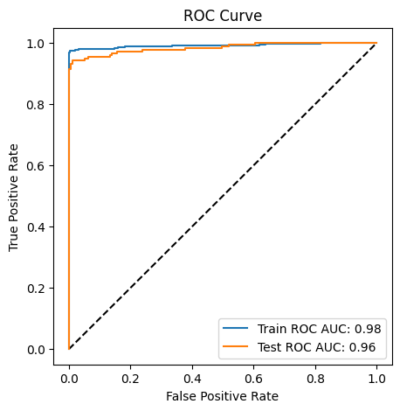
ML Model using ROC curve

Slide 12
ML Model:Multinomial Naïve Bayes
# ML Model - 1 Implementation
# Create a machine learning pipeline using scikit-learn, combining text vectorization (CountVectorizer)
# and a Multinomial Naive Bayes classifier for email spam detection.
clf = Pipeline([
('vectorizer', CountVectorizer()), # Step 1: Text data transformation
('nb', MultinomialNB()) # Step 2: Classification using Naive Bayes
])
# Model is trained (fit) and predicted in the evaluate model

Slide 13
METHODOLOGIES
Supervised Learning: Use labeled datasets of spam and legitimate emails to train classification models.
Natural Language Processing: Apply NLP techniques to extract meaningful features from email text and metadata.
Ensemble Methods: Combine multiple models, such as decision trees and random forests, for improved accuracy.
Continuous Model Refinement: Regularly update and retrain the model to adapt to evolving spam tactics.
Support Vector Machine (SVM): SVM is a formally defined discriminative supervised learning classifier that takes labeled examples for training and gives a hyperplane as output, classifying new data.

Slide 14
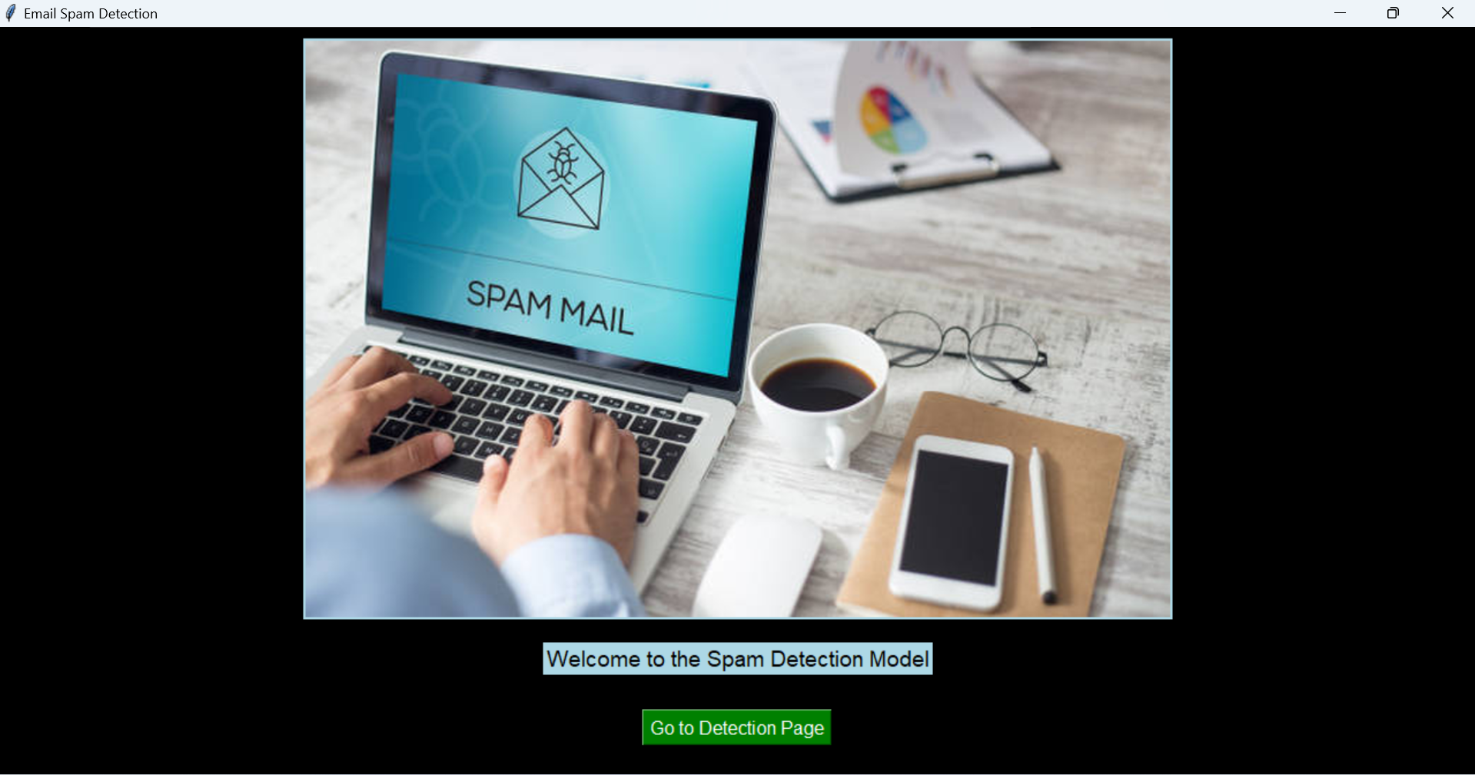
GUI

Slide 15
RESULTS
Accuracy: The machine learning model achieves over 95% accuracy in identifying spam emails.
False Positive Rate: The system maintains a low false positive rate, ensuring minimal disruption to legitimate email delivery.
Scalability: The solution can handle high volumes of email traffic with low latency and minimal computational resources.

Slide 16
CONCLUSION
The machine learning-based email spam detection system provides a highly effective solution to a significant problem. By accurately identifying and filtering out spam, the system enhances the overall email experience for users. Continuous model updates and refinements ensure the system remains adaptable to evolving spam tactics. In conclusion, this project has demonstrated that machine learning, combined with effective feature engineering and model selection, can be a powerful tool in the ongoing battle against email spam. By implementing this spam detection system, we've taken a significant step towards minimizing the impact of spam messages on email users' lives. Email inboxes are now a safer place, thanks to the successful implementation of our email spam detection system. As we conclude this project, we look forward to continued improvements and innovations in email security.

Slide 17
REFERENCES
For more information on the technical aspects and best practices of email spam detection using machine learning, please refer to the following resources:
https://onlinelibrary.wiley.com/doi/10.1155/2022/1862888
https://medium.com/@Coursesteach/spam-detection-using-machine-learning-methods-dd5dbc799b6b

